Slide 1
Business & Marketing and Econ Mrs. Ryfka Schafer

Slide 2
Current Business News
Business, Marketing, and Entrepreneurship Definitions
Business Formations

Slide 3
Current Business News Story – Individual Project
Due any class day before end of 1st semester.
Summarize a current business news story from any news source (New York Times, CNN, Fox News, Wall Street Journal, Time Magazine, ABC news, Seattle Times, Washington Post, etc.) Cannot be from social media.
Create visual slides on the news story
Slide 1: your name, title of the news article
Slide 2: summary of the business news story
Slide 3: background on the company that’s in the story
Slide 4: implications of this news on:
A) US economy
B) regulations, laws, or future policy
C) global world
D) students in this room: why is this important for us to know?/how could it affect us?
Slide 5: connection to anything specific we’ve been learning in class
Slide 6: thought provoking question(s) for the class to answer in discussion
Slide 7: source(s) used/ work cited in MLA format
Present your screen and speak to the class on the date you chose
Need to incorporate data, graphs, or statistics (some quantitative data to back up your information)
Be professional and creative in the visual presentation

Slide 4

Definition of Business
Describe what business is in a few words or phrase (note: can’t just be “money”)
Write your words on a stickynote
Sign your name to the sticky
Post it on one of the back whiteboards
This Photo by Unknown Author is licensed under CC BY-SA
Notes:
Commercialization of ideas

Slide 5

What is Business?
the practice of making one's living by engaging in commerce
a person's regular occupation, profession, or trade
A business is defined as an organization or enterprising entity engaged in commercial, industrial, or professional activities.
Businesses can be for-profit entities or non-profit organizations.
Business types range from limited liability companies to sole proprietorships, corporations, and partnerships.

Slide 6
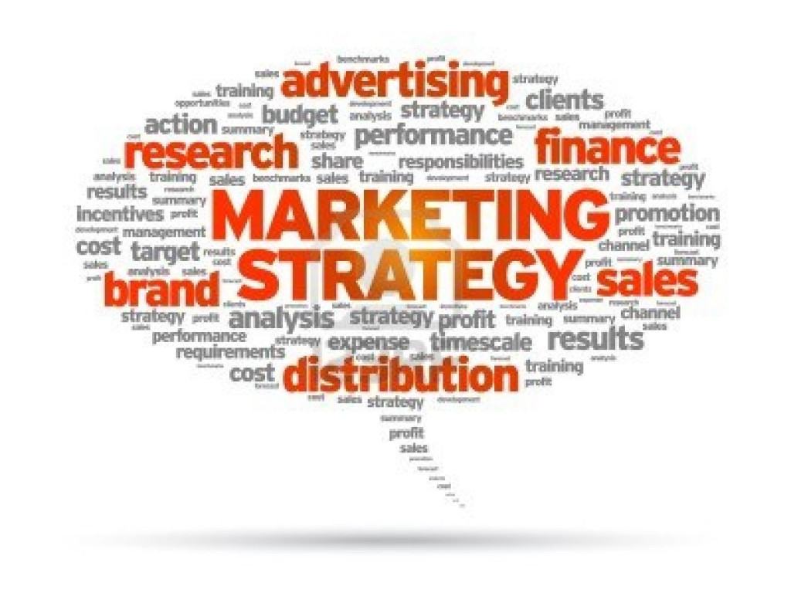
What is Marketing?
The process an organization undertakes to:
engage its target audience
build strong relationships to create value in order to capture value (money) in return
It is one of the primary components of business management and commerce.
Promoting and selling products or services, including market research and advertising.
This Photo by Unknown Author is licensed under CC BY-SA-NC

Slide 7

What is Entrepreneurship?
Entrepreneur: a person who organizes and operates a business or businesses, taking on greater than normal financial risks in order to do so
Entrepreneurship: the activity of setting up a business or businesses, taking on financial risks in the hope of profit.
Think about someone being the founder, starting things, etc.
This Photo by Unknown Author is licensed under CC BY-SA-NC

Slide 8
Forij
Parker Olson
Show investor pitch deck
Note how visual these slides are
Note how they tell a story (even if you just read the slide titles…)

Slide 9
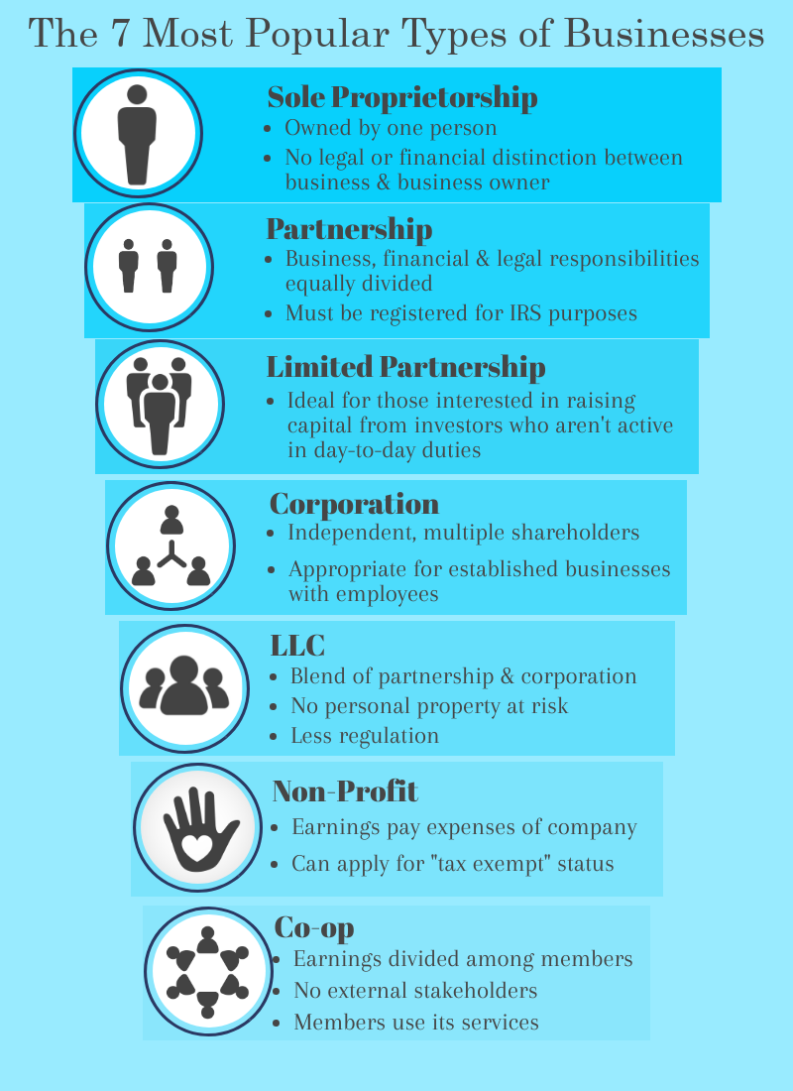
Different Business Formations

Slide 10
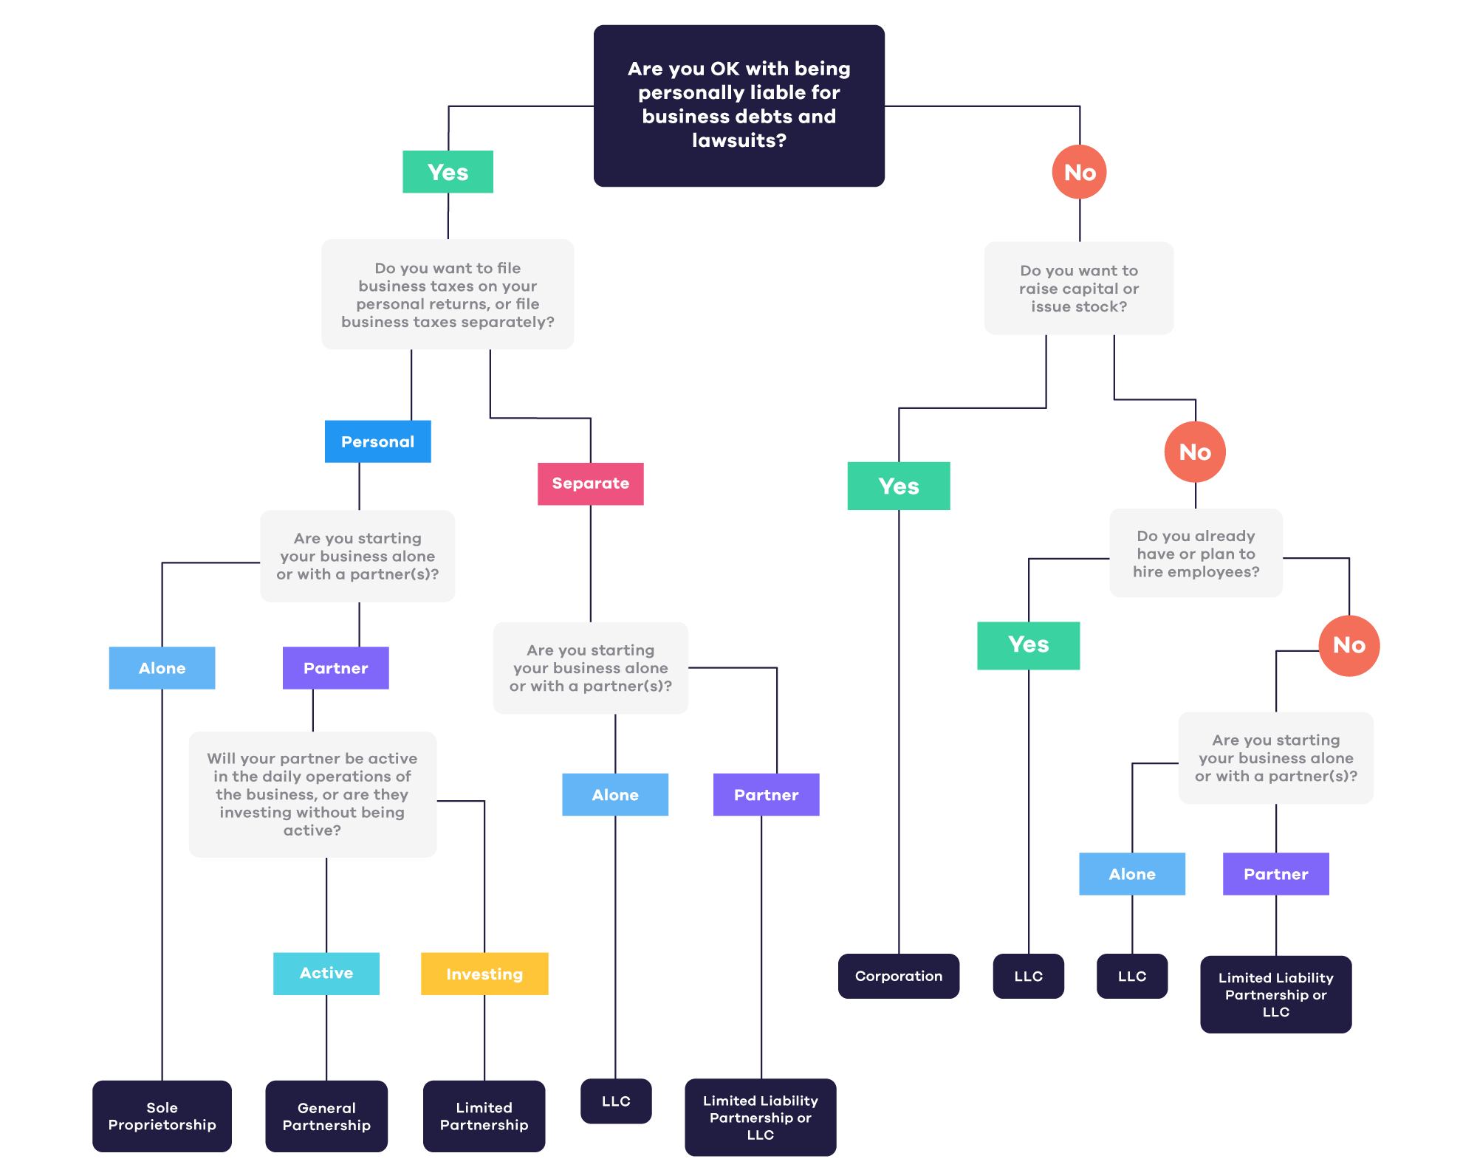

Slide 11



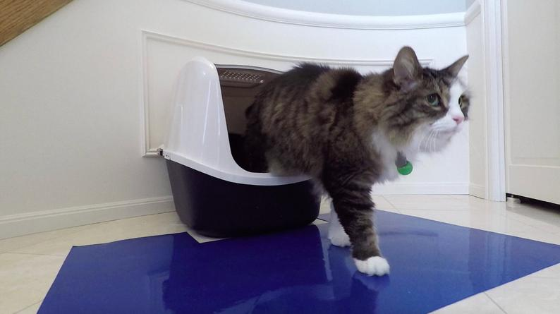
Two companies – what kind of business form do you think I used?
Amazon
Business of publishing
www.rorishay.com
Etsy Amazon YouTube
Alibaba
Prototyping, Trademark, Patent
Chewy.com buyer

Slide 12
Scenarios
Group 1: Donut shop; 1 owner
Group 2: 2 partners starting a dentist office
Group 3: Chemical manufacturing company
Group 4: Tech startup with 1 owner and a few investors
Group 5: Small grocery store where everyone volunteers there once a month
Group 6: Small group of students who want to create STEM resources for elementary school kids
Which business formation will you choose and why?

Slide 13
Assignment
Make a chart of advantages and disadvantages of each form of business (directions in Assignments on Teams)
Notes:
Make a table
by or with others oneself
Due? When
Use the slides and internet

